Slide 1
IMAGE CLASSIFICATION USING CONVOLUTIONAL NEURAL NETWORKING(CNN)
Group Members:
Nafisa Farhin – 14101113 – Section01 - Dataset analysis, Coding and environment set up
Israt Jahan Ritun – 14101114 – Section01 - Algorithm Analysis
Ferdousi Rahman – 15201004 – Section01 - Result Analysis, Presentation making & report writing

Slide 2
IMAGE CLASSIFICATION USING CONVOLUTIONAL NEURAL NETWORKING(CNN)
Supervised Learning
Specific Task – Identification
Area Covered – Image Processing with Neural Networking

Slide 3
Details of Dataset
CIFAR-10(Canadian Institute For Advanced Research)
Image Dataset - dataset contains a good number of images divided into different classes that we can use to train machine learning.
Consists 60000 32x32 color images in 10 classes
All the classes are mutually exclusive.
No null/empty values.
Can train large number of models in less time

Slide 4
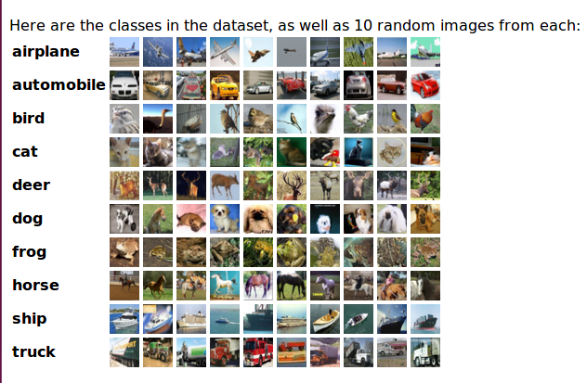
Details of Dataset

Slide 5
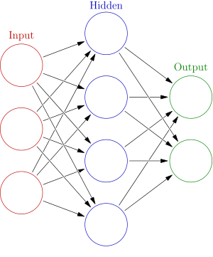
Algorithm - Neural Networking
A paradigm for processing information loosely based on the idea of neurons that communicate information in the brain & spinal cord.

Slide 6
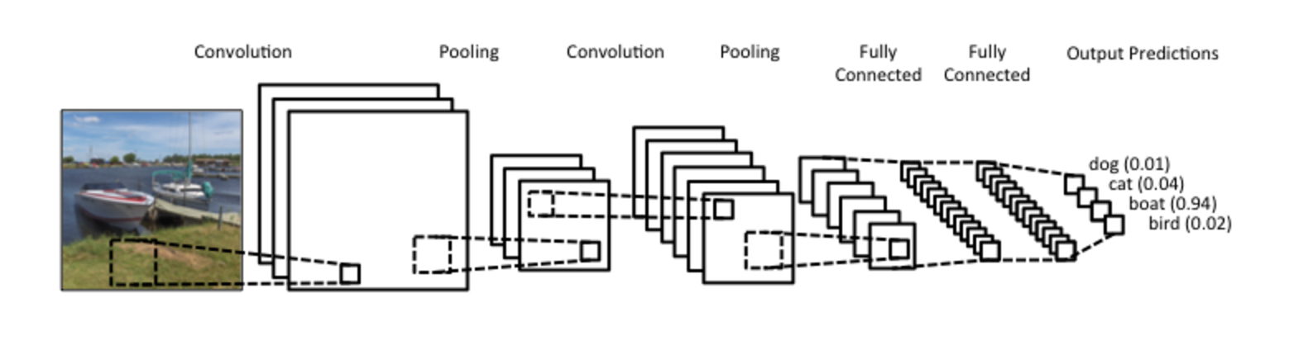
Details of Algorithm
Convolutional Neural Networking
A category of neural networks that can detect pattern and make sense of it & has proven very effective in image recognition & classification.
Comprised of one or more convolutional layers

Slide 7
Program Code
import numpy
from keras.datasets import cifar10
from keras.models import Sequential
from keras.layers import Dense
from keras.layers import Dropout
from keras.layers import Flatten
from keras.constraints import maxnorm
from keras.optimizers import SGD
from keras.layers.convolutional import Conv2D
from keras.layers.convolutional import MaxPooling2D
from keras.utils import np_utils
from keras import backend as K
K.set_image_dim_ordering('th')
# Plot ad hoc CIFAR10 instances
from matplotlib import pyplot
from scipy.misc import toimage
# input image dimensions
img_rows, img_cols = 32, 32
# load data
(X_train, y_train), (X_test, y_test) = cifar10.load_data()
# create a grid of 3x3 images
for i in range(0, 9):
pyplot.subplot(330 + 1 + i)
pyplot.imshow(toimage(X_train[i]))
# show the plot
pyplot.show()
# fix random seed for reproducibility
seed = 7
numpy.random.seed(seed)

Slide 8
Program Code(cont.)
#batch_size to train
batch_size = 32
# number of epochs to train
epochs = 2
# number of convolutional filters to use
nb_filters = 32
# size of pooling area for max pooling
nb_pool = 2
# convolution kernel size
nb_conv = 3
# load data
(X_train, y_train), (X_test, y_test) = cifar10.load_data()
# normalize inputs from 0-255 to 0.0-1.0
X_train = X_train.astype('float32')
X_test = X_test.astype('float32')
X_train = X_train / 255.0
X_test = X_test / 255.0
# one hot encode outputs
y_train = np_utils.to_categorical(y_train)
y_test = np_utils.to_categorical(y_test)
num_classes = y_test.shape[1]

Slide 9
Program Code(cont.)
# Create the model
model = Sequential()
model.add(Conv2D(nb_filters, (nb_conv, nb_conv), input_shape=(nb_conv,img_rows, img_cols),
padding='same', activation='relu', kernel_constraint=maxnorm(3)))
model.add(Dropout(0.2))
model.add(Conv2D(nb_filters, (nb_conv, nb_conv), activation='relu', padding='same',
kernel_constraint=maxnorm(3)))
model.add(MaxPooling2D(pool_size=(nb_pool, nb_pool)))
model.add(Flatten())
model.add(Dense(512, activation='relu', kernel_constraint=maxnorm(3)))
model.add(Dropout(0.5))
model.add(Dense(num_classes, activation='softmax'))
# Compile model
lrate = 0.01
decay = lrate/epochs
sgd = SGD(lr=lrate, momentum=0.9, decay=decay, nesterov=False)
model.compile(loss='categorical_crossentropy', optimizer=sgd, metrics=['accuracy'])
print(model.summary())
# Fit the model
model.fit(X_train, y_train, validation_data=(X_test, y_test), epochs=epochs,batch_size=batch_size)
# Final evaluation of the model
scores = model.evaluate(X_test, y_test, verbose=0)
print("Accuracy: %.2f%%" % (scores[1]*100))

Slide 10
Output of the Program
Time required for per step
Loss of value during each epoch
Identification of image
Interpret our results in terms of accuracy

Slide 11
Reference:
Where did we get the idea? – journal
Where did we get the dataset? - http://www.cs.toronto.edu/~kriz/cifar.html
Where did we find the code? - https://github.com/vgupta-ai/Cifar-10-Classification-CNN-Keras/blob/master/Cifar10-Deeper-CNN-Classifier.py
Which tutorial are we following? - https://machinelearningmastery.com/

Slide 12
Conclusion:
Our Expectation – Maximum accuracy possible in image identification

Slide 13


